Slide 1
Unit 6
Genetic Algorithm
Intelligence can be defined as the capability of a system to adapt its behaviour to an ever-changing environment. According to Alan Turing (Turing, 1950), the form or appearance of a system is irrelevant to its intelligence.

Slide 2
Course Content
Introduction
Genetic Algorithm
Procedure of Genetic Algorithm
The Working of Genetic Algorithm
The logic Behind Genetic Algorithm
Evolutionary Computing

Slide 3
Introduction
Algorithm: An algorithm is a sequence of instructions to solve a problem. Most of the algorithms are static.
A Genetic Algorithm(GA) is adaptive (dynamic) model of machine learning algorithm that derives its behavior from a metaphor of some of the mechanisms of evolution in nature.

Slide 4
Background
On 1 July 1858, Charles Darwin , presented his theory of evolution. This day marks the beginning of a revolution in Biology.
Darwin’s classical theory of evolution , together with Weismann’s theory of natural selection and Mandel’s concept of genetics , now represent the neo-Darwinism
Neo-Darwinism is based on process of reproduction, mutation, competition and selection.

Slide 5
Background
Evolution can be seen as a process leading to the maintenance of a population’s ability to survive and reproduce in a specific environment. This ability is called evolutionary fitness.
Evolutionary fitness can also be viewed as a measure of the organism’s ability to anticipate changes in its environment.
The fitness, or the quantitative measure of the ability to predict environmental changes and respond adequately, can be considered as the quality that is optimized in natural life

Slide 6
Evolutionary Computation
Evolutionary Computation stimulates evolution on a computer. The result of such simulations is a sense of optimisation algorithms
Optimisation iteratively improves the quality of solutions until an optimal, or near-optimal, solution is found
The evolutionary approach is based on computational models of natural selection and genetics. We call them evolutionary computation ,an umbrella term that combines genetic algorithms, evolution strategies and genetic programming

Slide 7
Simulation of Natural Evolution
All methods of evolutionary computation simulate natural evolution by creating a population of individuals, evaluating their fitness, generating a new population through genetic operations, and repeating this process a number of times.
We focus on Genetic Algorithm as most of the other algorithms can be viewed as variations of genetic algorithms.

Slide 8
Genetic Algorithm
In early 1970s John Holland introduced the concept of genetic algorithm
His aim was to make computers do what nature does. Holland was concerned with algorithms that manipulate strings of binary digits
Each artificial “chromosomes” consists of a number of “genes”, and each gene is represented by 0 or 1
1 | 0 | 1 | 1 | 0 | 1 | 0 | 0 | 0 | 0 | 0 | 1 | 0 | 1 | 0 | 1

Slide 9
Genetic Algorithm
Two mechanisms link a GA to the problem it is solving : Encoding and Evaluation
The GA uses a measure of fitness of individual chromosomes to carry out reproduction. As reproduction takes place, the crossover operator exchanges part of two single chromosomes and he mutation operator changes the gene value in some randomly chosen location of the chromosome

Slide 10
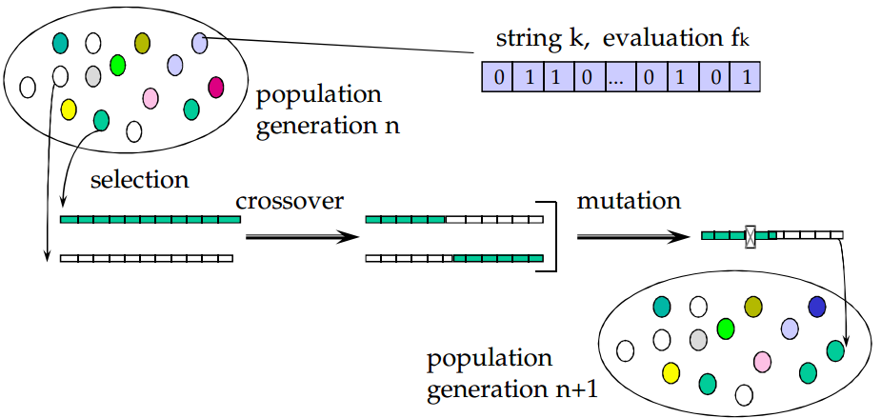
Basic Genetic Algorithm

Slide 11
Genetic Algorithm
GA Operators and Parameters
Fitness function: The fitness function is defined over the genetic representation and measures the quality of the represented solution.
Selection Operator: Selects parents for reproduction based on relative fitness of candidates in the population
Roulette Wheel Selection
Ranking Selection

Slide 12
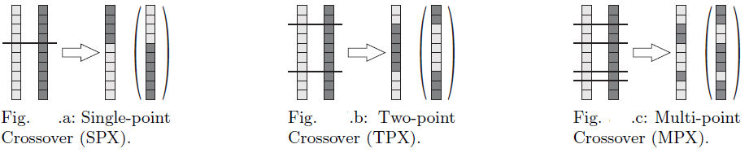
Genetic Algorithm
Crossover Operator:
Exchanges part of chromosome between two parent chromosomes with some crossover rate(probability), typically 0.4 – 0.8
The main operator to provide exploitation in search building up good genes in chromosome
One Point Crossover: randomly chooses a crossover point where two parent chromosomes “break” and then exchanges the chromosome parts after that point. As a result, two new offspring is created
Two Point Crossover: randomly chooses two crossover points in two parent chromosomes, and then exchanges the chromosome parts between these points. As a result, two new offspring are created.

Slide 13
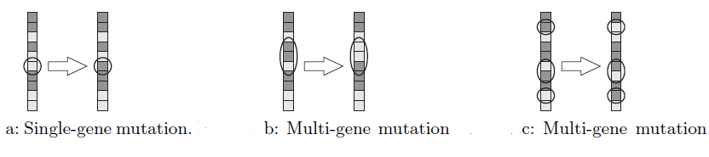
Genetic Algorithm
Mutation Operator:
Changes a randomly selected gene in the chromosome
mimics random changes in genetic code
Background operator to provide exploration in search to avoid being trapped on a local optimum
Mutation probability is quiet small in nature and is kept low for GAs, typically in the range between [ 0.001 – 0.01] or by formula :
P(m) = 1/no, of bits in Chromosomes

Slide 14
Genetic Algorithm
Elitism Approach : Saves the best individual in next generation
Basic GA Parameters:
Population size
Crossover rate (Probability)
Mutation Rate (Probability)
Number of Generation ( a Stopping Criterion)

Slide 15
Steps in Genetic Algorithm
Represent the problem variable as a chromosome of a fixed length, choose the size of a chromosome population N, the crossover probability pc and the mutation probability pm.
Define a fitness function to measure the fitness of an individual chromosome in the problem domain.
Randomly generate an initial population of chromosomes of size N: x1, x2,.., xN
Calculate the fitness of each individual chromosome: f(x1), f(x2), . . . , f(xN)
Select a pair of chromosomes for mating from the current population based on their fitness.
Create a pair of offspring chromosomes by applying the genetic operators − crossover and mutation.
Place the created offspring chromosomes in the new population.
Repeat Step 5 until the size of the new chromosome population becomes equal to the size of the initial population, N.
Replace the initial (parent) chromosome population with the new (offspring) population.
Go to Step 4, and repeat the process until the termination criterion is satisfied
FLOW CHART

Slide 16
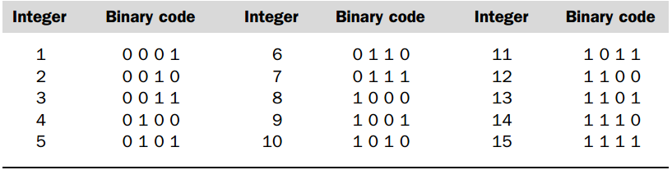

Genetic Algorithm : Case Study
A simple Example will help understand how a GA works. Let is find the maximum value of the function $(15x −x^{2})$ where parameter $x$ varies between 0 and 15. For simplicity, we may assume that $x$ takes only integer values
Mathematically this is an optimisation problem : find the value of variable $x$ so that max($15x −x^{2}$) such that $0≤x≤15 x∀ integers$
Representation (Encoding)

Slide 17
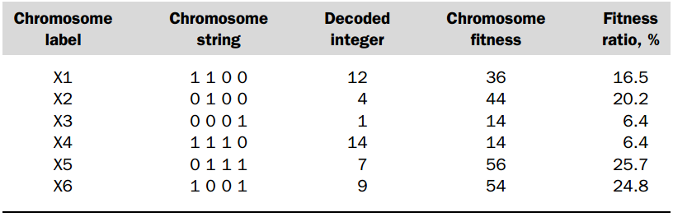

GA : Case Study
Fitness Function : The Fitness function in put example is defined by
$$f\left(x\right)=15x − x^{2}$$
the solution (i.e. value of x is better when this value if high
GA Operator and Parameter: suppose the size of the chromosome population is N is 6, the crossover probability $p_{c}=0.7,$ and mutation probability $p_{m}=0.001$
Fig: initially randomly
generated population
of Chromosomes

Slide 18
GA: Case Study
In natural selection, only the fittest species can survive, breed, and thereby pass their genes on to the next generation. GAs use a similar approach, but unlike nature, the size of the chromosome population remains unchanged from one generation to the next.
The last column in Table shows the ratio of the individual chromosome’s fitness to the population’s total fitness. This ratio determines the chromosome’s chance of being selected for mating. The chromosome’s average fitness improves from one generation to the next

Slide 19
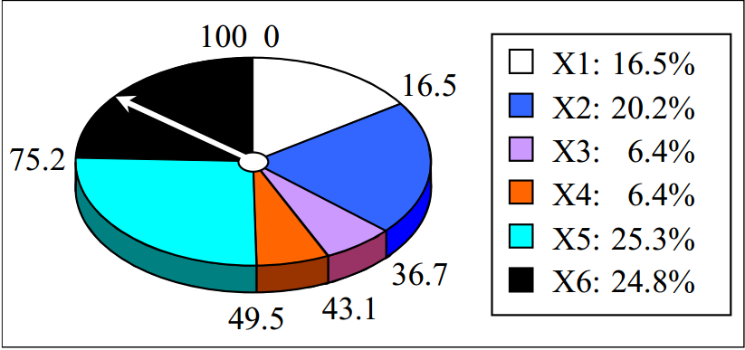
GA: Case Study
Roulette-Wheel Selection
The most commonly used chromosome selection texhnique is the roulette wheel selection.

Slide 20
GA: Case Study
In our example, we have an initial population of 6 chromosomes. Thus, to establish the same population in the next generation, the roulette wheel would be spun six times.
Once a pair of parent chromosomes is selected, the crossover operator is applied
If needed Mutation is also carried out to avoid being trapped in local minimum

Slide 21
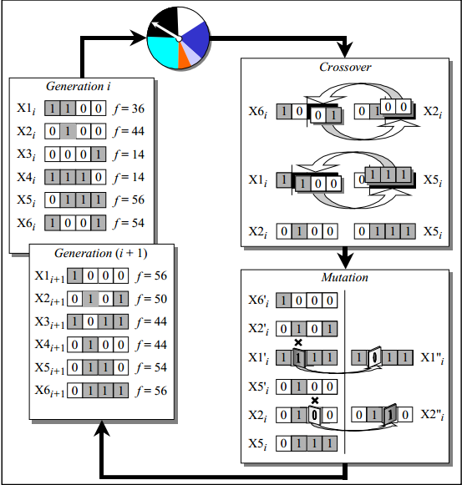
GA: Case Study
The Genetic Algorithm Cycle

Slide 22
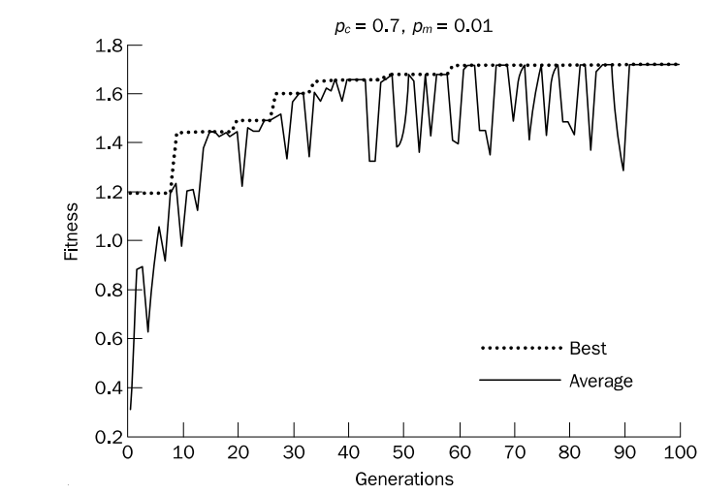
Genetic Algorithm

Slide 23
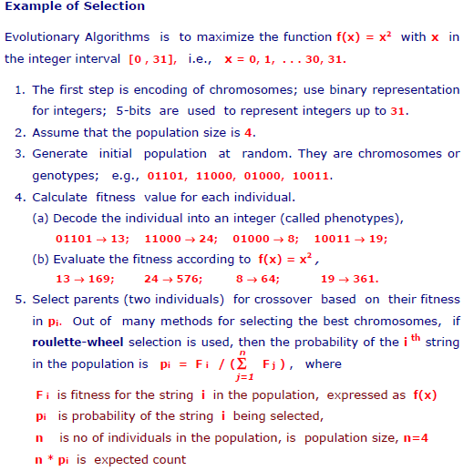
GA : Case Study 2

Slide 24
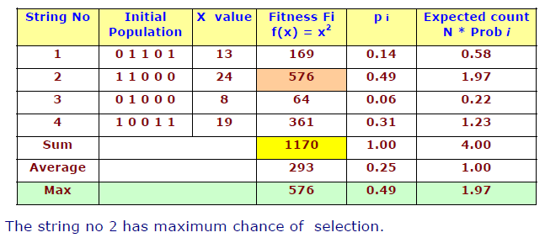
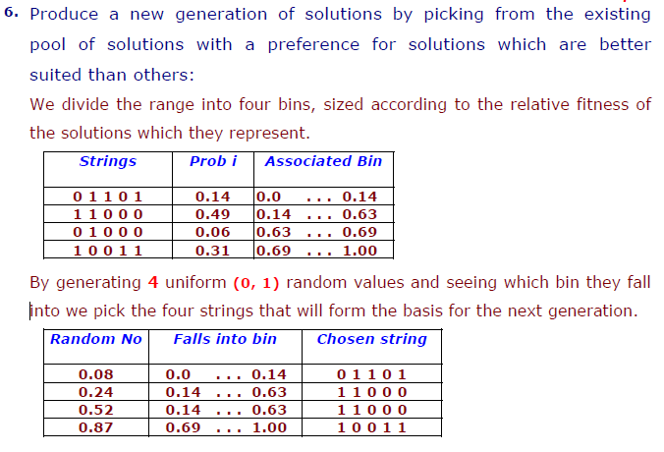
GA : Case Study 2

Slide 25
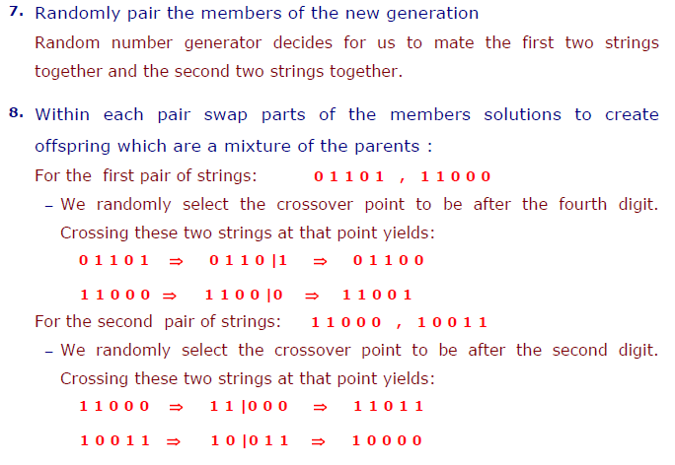
GA : Case Study 2

Slide 26
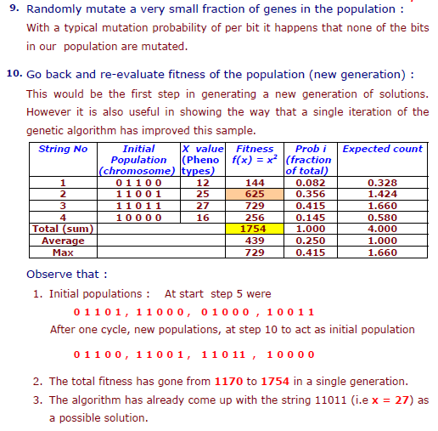
GA : Case Study 2

Slide 27
Genetic Algorithm
Genetic algorithms are used to solve many large problems including:
-Scheduling
- Transportation
-Chemistry, Chemical Engineering
- Layout and circuit design
-Medicine
-Data Mining and Data Analysis
-Economics and Finance
-Networking and Communication
- Game etc.

Slide 28
Genetic Algorithm
GA Advantages and Disadvantages
Advantages:
It can solve every optimization problem which can be described with the chromosome encoding.
It solves problems with multiple solutions.
Since the genetic algorithm execution technique is not dependent on the error surface, we can solve multi-dimensional, non-differential, non-continuous, and even non-parametrical problems.
Structural genetic algorithm gives us the possibility to solve the solution structure and solution parameter problems at the same time by means of genetic algorithm.
Genetic algorithm is a method which is very easy to understand and it practically does not demand the knowledge of mathematics.
Genetic algorithms are easily transferred to existing simulations and model
Disadvantages
May be Slow
May be drop of the quality because of crossover.

Slide 29
References:
Artificial Intelligence A Guide to Intelligent Systems: Michael Negnevitsky [2ed]

